Slide 1
Software Engineering
Fall 2021
Level 3, Term II
Course Code: CSE 319
Credit Hr. 3.00
Contact Hr. 3.00
Lec Tarannum Zaki
Dept. of CSE
MIST

Slide 2
Course Teachers
Asst Prof T M Shahriar Sazzad
Contact: tss7standrews@gmail.com
Lec Tarannum Zaki
Contact: tarannumzaki@yahoo.com
Class Schedule (online until further notice)
Sunday – 12.45 PM to 14.40 PM
Wednesday – 08.00 AM to 08.55 AM
Communication Medium (both section A & B)
Google Classroom
Class Code: lt2wd57

Slide 3
Course Objectives
To understand the process of designing, building, and maintaining software systems.
To acquire the skill of software project management.
To understand software evolution, testing approaches and quality assurance to ensure high standard/ professional software.

Slide 4
Course Outcomes
CO1: Understand and applying the fundamentals of software development process.
CO2: Analyze the user requirements, and designing different kind of system and architectural models for building software systems.
CO3: Develop testing mechanisms for assuring software quality including the dependability and availability.
CO4: Develop the communication skill by presenting topics on software engineering.

Slide 5
OBE-based Assessment
Components |  | Grading
Continuous Assessment (40%) | Class Test 1-3 | 20%
 | Class Participation/Attendance | 5%
 | Mid term | 15%
Final Exam |  | 60%
Total Marks |  | 100%

Slide 6
Text/Reference Books
Software Engineering (10th Edition) by Ian Sommerville
Software Engineering – a practitioner’s Approach (7th Edition) by Roger S. Pressman
Software Engineering: Principles and Practice (3rd Edition) by Hans van Vliet

Slide 7
Chapter 1- Introduction

Slide 8
Topics Covered
Introduction
Basic concept of software engineering
Professional software development

Slide 9
Importance of Software Engineering
The economies of all developed nations are dependent on software.
More and more systems are becoming software controlled.
Automation through software simplifies different system/process of our daily life activities.
Software engineering is not only limited to development but also concerned with theories, methods and tools for professional software development.

Slide 10
Software Engineering
Software engineering is an engineering discipline that is concerned with all aspects of software production from the early stages of system specification through to maintaining the system after it has gone into use.
Engineering discipline
Using appropriate theories and methods to solve problems bearing in mind organizational and financial constraints.
All aspects of software production
Not just technical process of development. Also, project management and the development of tools, methods etc. to support software production.

Slide 11
Software Engineering
S/W Engg. must understand the customer’s business needs and design software to help them.
Thus, SW engineering task requires:
Ability to quickly learn new and diverse disciplines and business processes.
Ability to communicate with domain experts, extract an abstract model of the problem, and formulate a solution.
Ability to design the software systems for the proposed solution to meet the business needs for many years.

Slide 12
The Role of Software Engineering
Software engineering is often confused with Programming
S/W engineering is the creative activity of understanding the business problems, coming up with an idea for solution, and designing the ‘blueprints’ of the solution.
Programming is the craft of implementing the given blueprints.

Slide 13
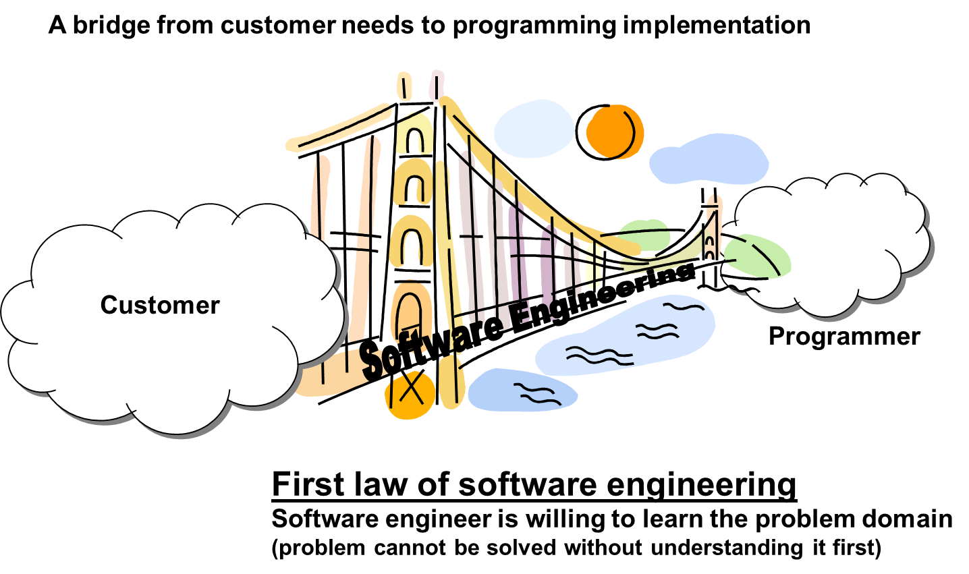
The Role of Software Engineering

Slide 14
The Role of Software Engineering

Slide 15
The Role of Software Engineering
Some people say: “SW engineering is about writing loads of documentation”
Other people say: “SW engineering is about a running code”
It is neither one!
SW Engg. is helpful to document the process (not the final solution) to know what alternatives were considered and why particular choice were made.
SW Engg. is about delivering value for the customer, and both code and documentation are valuable.

Slide 16
The Role of Software Engineering
Complex
≠
Complicated
Complex = composed of many simple parts related to one another
Complicated = not well understood, or explained

Slide 17
Example: ATM Machine
Understanding the money-machine problem:

Slide 18
How ATM Machine Might Work
Domain model created with help of domain expert

Slide 19
Cartoon Strip: How ATM Machine Works

Slide 20
Software Engineering Blueprints
Specifying software problems and solutions is like cartoon strip writing
Unfortunately, most of us are not artists, so we will use something less exciting: UML (Unified Modeling Language) symbols

Slide 21
Second Law of Software Engineering
Software should be written for people first
(Computers run software, but hardware quickly becomes outdated)
Useful + good software lives long
To nurture software, people must be able to understand it

Slide 22
Software Engineering Lifecycle
Software specification, where customers and engineers define the software that is to be produced and the constraints on its operation.
Software development, where the software is designed and programmed.
Software validation, where the software is checked to ensure that it is what the customer requires.
Software evolution, where the software is modified to reflect changing customer and market requirements.

Slide 23
Software Development Methods
Method = work strategy
The Feynman Problem-Solving Algorithm:
(i) Write down the problem
(ii) think very hard, and
(iii) write down the answer.
Waterfall
Unidirectional, finish this step before moving to the next
Iterative + Incremental
Develop increment of functionality, repeat in a feedback loop
Agile
User feedback essential; feedback loops on several levels of granularity

Slide 24
Professional Software Development

Slide 25
Software Costs
Software costs often dominate computer system costs. The costs of software on a PC are often greater than the hardware cost.
Software costs more to maintain than it does to develop. For systems with a long life, maintenance costs may be several times development costs.
Software engineering is concerned with cost-effective software development.

Slide 26
Software Project Failure
Increasing system complexity
As new software engineering techniques help us to build larger, more complex systems, the demands change. Systems have to be built and delivered more quickly; larger, even more complex systems are required; systems have to have new capabilities that were previously thought to be impossible.
Failure to use software engineering methods
It is fairly easy to write computer programs without using software engineering methods and techniques. Many companies have drifted into software development as their products and services have evolved. They do not use software engineering methods in their everyday work. Consequently, their software is often more expensive and less reliable than it should be.

Slide 27
Frequently asked questions about Software Engineering
Question | Answer
What is software? | Computer programs and associated documentation. Software products may be developed for a particular customer or may be developed for a general market.
What are the attributes of good software? | Good software should deliver the required functionality and performance to the user and should be maintainable, dependable and usable.
What is software engineering? | Software engineering is an engineering discipline that is concerned with all aspects of software production.
What are the fundamental software engineering activities? | Software specification, software development, software validation and software evolution.
What is the difference between software engineering and computer science? | Computer science focuses on theory and fundamentals; software engineering is concerned with the practicalities of developing and delivering useful software.
What is the difference between software engineering and system engineering? | System engineering is concerned with all aspects of computer-based systems development including hardware, software and process engineering. Software engineering is part of this more general process.

Slide 28
Frequently asked questions about software engineering
Question | Answer
What are the key challenges facing software engineering? | Coping with increasing diversity, demands for reduced delivery times and developing trustworthy software.
What are the costs of software engineering? | Roughly 60% of software costs are development costs, 40% are testing costs. For custom software, evolution costs often exceed development costs.
What are the best software engineering techniques and methods? | While all software projects have to be professionally managed and developed, different techniques are appropriate for different types of system. For example, games should always be developed using a series of prototypes whereas safety critical control systems require a complete and analyzable specification to be developed. You can’t, therefore, say that one method is better than another.
What differences has the web made to software engineering? | The web has led to the availability of software services and the possibility of developing highly distributed service-based systems. Web-based systems development has led to important advances in programming languages and software reuse.

Slide 29
Software Products
Generic Products
Stand-alone systems that are marketed and sold to any customer who wishes to buy them.
Examples – PC software such as graphics programs, project management tools; CAD software; software for specific markets such as appointments systems for dentists.
Customized Products
Software that is commissioned by a specific customer to meet their own needs.
Examples – embedded control systems, air traffic control software, traffic monitoring systems.

Slide 30
Product Specification
Generic Products
The specification of what the software should do is owned by the software developer and decisions on software change are made by the developer.
Customized Products
The specification of what the software should do is owned by the customer for the software and they make decisions on software changes that are required.

Slide 31
Essential Attributes of Good Software
Product characteristic | Description
Maintainability | Software should be written in such a way so that it can evolve to meet the changing needs of customers. This is a critical attribute because software change is an inevitable requirement of a changing business environment.
Dependability and security | Software dependability includes a range of characteristics including reliability, security and safety. Dependable software should not cause physical or economic damage in the event of system failure. Malicious users should not be able to access or damage the system.
Efficiency | Software should not make wasteful use of system resources such as memory and processor cycles. Efficiency therefore includes responsiveness, processing time, memory utilisation, etc.
Acceptability | Software must be acceptable to the type of users for which it is designed. This means that it must be understandable, usable and compatible with other systems that they use.

Slide 32
General Issues that Affect Software
Heterogeneity
Increasingly, systems are required to operate as distributed systems across networks that include different types of computer and mobile devices.
Business and social change
Business and society are changing incredibly quickly as emerging economies develop and new technologies become available. They need to be able to change their existing software and to rapidly develop new software.

Slide 33
General issues that affect software
Security and trust
As software is intertwined with all aspects of our lives, it is essential that we can trust that software.
Scale
Software has to be developed across a very wide range of scales, from very small embedded systems in portable or wearable devices through to Internet-scale, cloud-based systems that serve a global community.

Slide 34
Software Engineering Diversity
There are many different types of software system and there is no universal set of software techniques that is applicable to all of these.
The software engineering methods and tools used depend on –
The type of application being developed.
The requirements of the customer.
The background of the development team.

Slide 35
Application Types
Stand-alone applications
These are application systems that run on a local computer, such as a PC. They include all necessary functionality and do not need to be connected to a network.
Interactive transaction-based applications
Applications that execute on a remote computer and are accessed by users from their own PCs or terminals. These include web applications such as e-commerce applications.
Embedded control systems
These are software control systems that control and manage hardware devices. Numerically, there are probably more embedded systems than any other type of system.

Slide 36
Application Types
Batch processing systems
These are business systems that are designed to process data in large batches. They process large numbers of individual inputs to create corresponding outputs.
Entertainment systems
These are systems that are primarily for personal use and which are intended to entertain the user.
Systems for modeling and simulation
These are systems that are developed by scientists and engineers to model physical processes or situations, which include many, separate, interacting objects.

Slide 37
Application Types
Data collection systems
These are systems that collect data from their environment using a set of sensors and send that data to other systems for processing.
Systems of systems
These are systems that are composed of a number of other software systems.

Slide 38
Software Engineering Fundamentals
Some fundamental principles apply to all types of software system, irrespective of the development techniques used:
Systems should be developed using a managed and understood development process. Of course, different processes are used for different types of software.
Dependability and performance are important for all types of system.
Understanding and managing the software specification and requirements (what the software should do) are important.
Where appropriate, you should reuse software that has already been developed rather than write new software.

Slide 39
THANK YOU

